Slide 1

Weak values extraction from neutron interferograms
Ismaele Vincent Masiello

Slide 2
Content

Slide 3
Content
Part 1: Motivation and goal

Slide 4
Content
Part 1: Motivation and goal
Part 2: Introduction to weak values

Slide 5
Content
Part 1: Motivation and goal
Part 2: Introduction to weak values
Part 3: Weak values based description of a Mach-Zehnder interferometer

Slide 6
Content
Part 1: Motivation and goal
Part 2: Introduction to weak values
Part 3: Weak values based description of a Mach-Zehnder interferometer
Part 4: Experimental measurement of path weak values directly from interferograms

Slide 7
Part 1: Motivation and goal

Slide 8




Motivation
Mach-Zehnder interferometry:

Slide 9
Motivation
Mach-Zehnder interferometry:
Particle

Slide 10
Motivation
Mach-Zehnder interferometry:
Path superposition

Slide 11
Motivation
Mach-Zehnder interferometry:
Path superposition
2
1

Slide 12
Motivation
Mach-Zehnder interferometry:
Recombined paths
?
?

Slide 13
Motivation
Mach-Zehnder interferometry:
Interference!

Slide 14

Motivation
Mach-Zehnder interferometry:

Slide 15

Motivation
Mach-Zehnder interferometry:

Slide 16
Motivation
Mach-Zehnder interferometry:

Slide 17

Motivation
Mach-Zehnder interferometry:

Slide 18
Motivation
Weak values carry information about an observable in between states
in the limit of minimum disturbance

Slide 19
Goal
Use weak values for a new perspective on interferometry and hopefully gain some new insights!

Slide 20
Part 2: Introduction to weak values

Slide 21


Weak value
Definition:

Slide 22
Weak value
Definition:

Slide 23
Weak value
Observable:
Pre-selected state:
Post-selected state:
Definition:

Slide 24

Weak value
Observable:
Pre-selected state:
Post-selected state:
Definition:
Expectation value:

Slide 25
Weak value
Observable:
Pre-selected state:
Post-selected state:
Not bounded by eigenvalues
Definition:
Expectation value:

Slide 26
Weak value
Observable:
Pre-selected state:
Post-selected state:
Not bounded by eigenvalues
Complex number
Definition:
Expectation value:

Slide 27

Weak value
Observable:
Pre-selected state:
Post-selected state:
Not bounded by eigenvalues
Complex number
Real
Imaginary

Slide 28
Weak value
Observable:
Pre-selected state:
Post-selected state:
Not bounded by eigenvalues
Complex number
Real
Imaginary
Describes the observable in the limit of minimal disturbance

Slide 29
Part 3: Weak values based description of interferometry

Slide 30

Standard interferometry formalism

Slide 31
Standard interferometry formalism

Slide 32
Standard interferometry formalism

Slide 33
Standard interferometry formalism

Slide 34

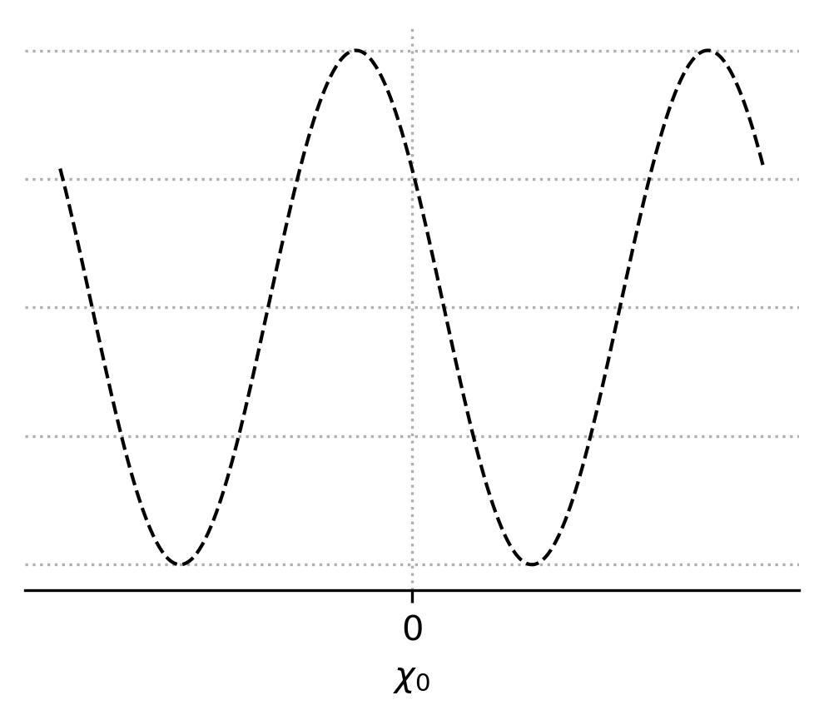
Standard interferometry formalism
Measured intensity

Slide 35
Standard interferometry formalism
Measured intensity
Interferogram

Slide 36
Weak value picture

Slide 37
Weak value picture
Pre-selection

Slide 38
Weak value picture
Pre-selection
Interaction

Slide 39

Weak value picture
Pre-selection
Interaction

Slide 40
Weak value picture
Pre-selection
Interaction
Post-selection

Slide 41
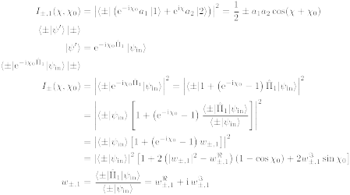
Weak value picture
Path weak value

Slide 42
Weak value picture
Measured intensity

Slide 43
Weak value picture
Measured intensity
Amplitude
square

Slide 44
Weak value picture
Measured intensity
Real part
Amplitude
square

Slide 45
Weak value picture
Measured intensity
Real part
Amplitude
square
Imaginary
part

Slide 46
Weak value picture
Measured intensity

Slide 47

Weak value picture
Measured intensity

Slide 48
Weak value picture
Almost there...

Slide 49
Weak value picture
Almost there...
Interferogram

Slide 50
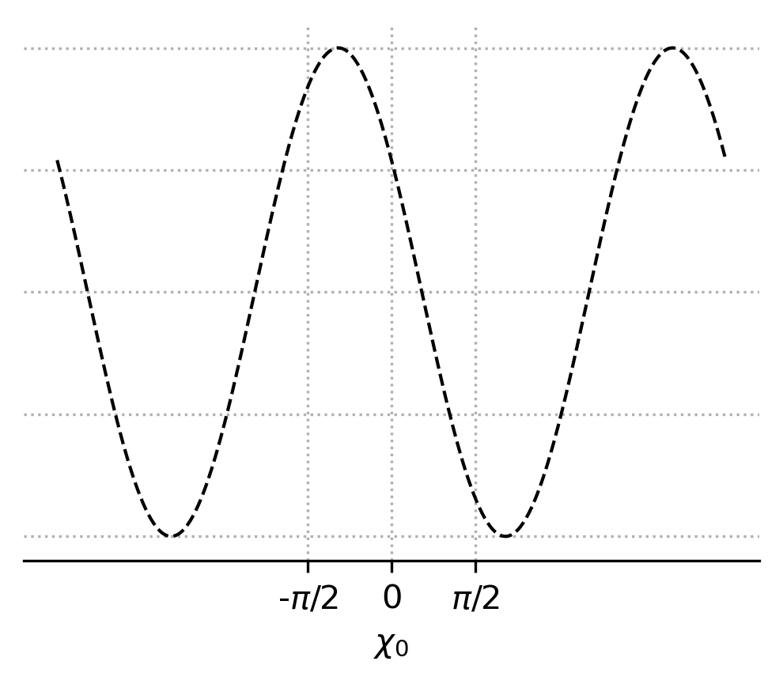
Weak value picture
Almost there...
Interferogram

Slide 51
Weak value picture
Almost there...

Slide 52
Weak value picture
Almost there...

Slide 53
Weak value picture
Almost there...

Slide 54
Weak value picture
Almost there...
Quadratic equation

Slide 55
Weak value picture
Almost there...
Quadratic equation
2 solutions

Slide 56
Weak value picture
Almost there...

Slide 57

Weak value picture
Almost there...

Slide 58
Weak value picture
Path blocker

Slide 59

Weak value picture
Pre-selection
Interaction
Post-selection
Path blocker

Slide 60
Weak value picture
Measured intensity

Slide 61
Weak value picture
Measured intensity

Slide 62
Weak value picture
Measured intensity

Slide 63
Weak value picture
We got there!

Slide 64
Part 4: Experimental measurement of path weak value from interferograms

Slide 65

Neutron interferometer

Slide 66
Setup

Slide 67
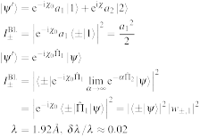
Setup
Unpolarised
neutron beam
1
1

Slide 68
Setup
Unpolarised
neutron beam
1
2
Neutron
interferometer
2
1

Slide 69
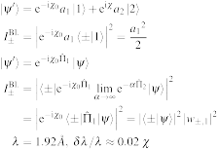
Setup
Unpolarised
neutron beam
1
2
Neutron
interferometer
2
1
Phase-shifter
3
3

Slide 70
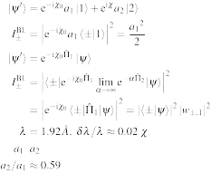
Setup
Unpolarised
neutron beam
1
2
Neutron
interferometer
2
1
4
Phase-shifter
3
3
Indium foils
to adjust path
amplitudes
4

Slide 71
Setup
Unpolarised
neutron beam
1
Pre-selection
2
Neutron
interferometer
2
1
4
Phase-shifter
3
3
Indium foils
to adjust path
amplitudes
4

Slide 72
Setup
Unpolarised
neutron beam
1
Pre-selection
5
2
Neutron
interferometer
2
1
4
Phase-shifter
3
3
Indium foils
to adjust path
amplitudes
4
Cadmium
path blocker
5

Slide 73
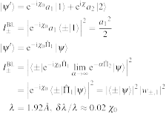
Setup
Unpolarised
neutron beam
1
Pre-selection
5
2
Neutron
interferometer
2
1
4
Phase-shifter
3
3
6
Indium foils
to adjust path
amplitudes
4
Cadmium
path blocker
Phase-shifter
5
6

Slide 74
Setup
Unpolarised
neutron beam
1
Pre-selection
Interaction
5
2
Neutron
interferometer
2
1
4
Phase-shifter
3
3
6
Indium foils
to adjust path
amplitudes
4
Cadmium
path blocker
Phase-shifter
5
6

Slide 75
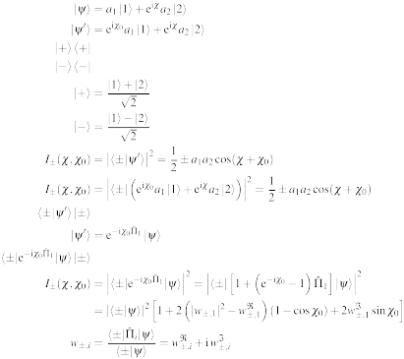
Setup
Unpolarised
neutron beam
1
Pre-selection
Interaction
5
2
Neutron
interferometer
2
1
4
7
Phase-shifter
3
3
6
Indium foils
to adjust path
amplitudes
8
4
Cadmium
path blocker
Phase-shifter
-detector
5
6
-detector
7
8

Slide 76
Setup
Unpolarised
neutron beam
1
Pre-selection
Interaction
Post-selection
and
measurement
5
2
Neutron
interferometer
2
1
4
7
Phase-shifter
3
3
6
Indium foils
to adjust path
amplitudes
8
4
Cadmium
path blocker
Phase-shifter
-detector
5
6
-detector
7
8

Slide 77
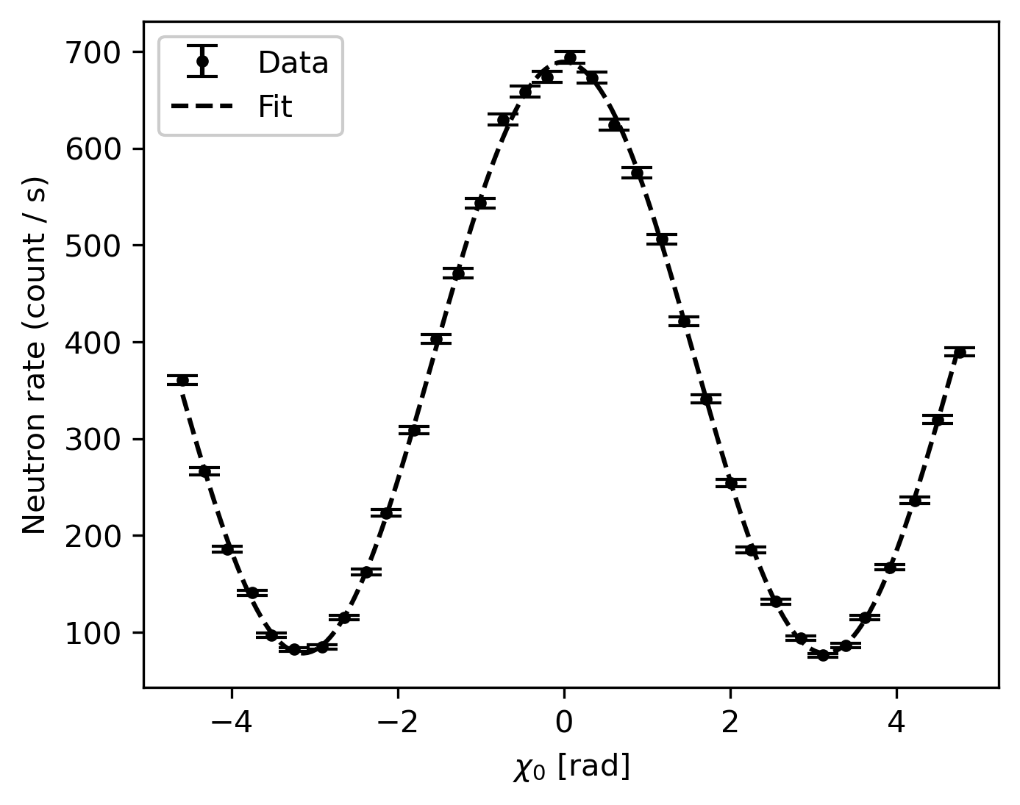
Example of interferogram

Slide 78
Example of interferogram
Real part
Imaginary part

Slide 79
Example of interferogram
Real part
Imaginary part

Slide 80
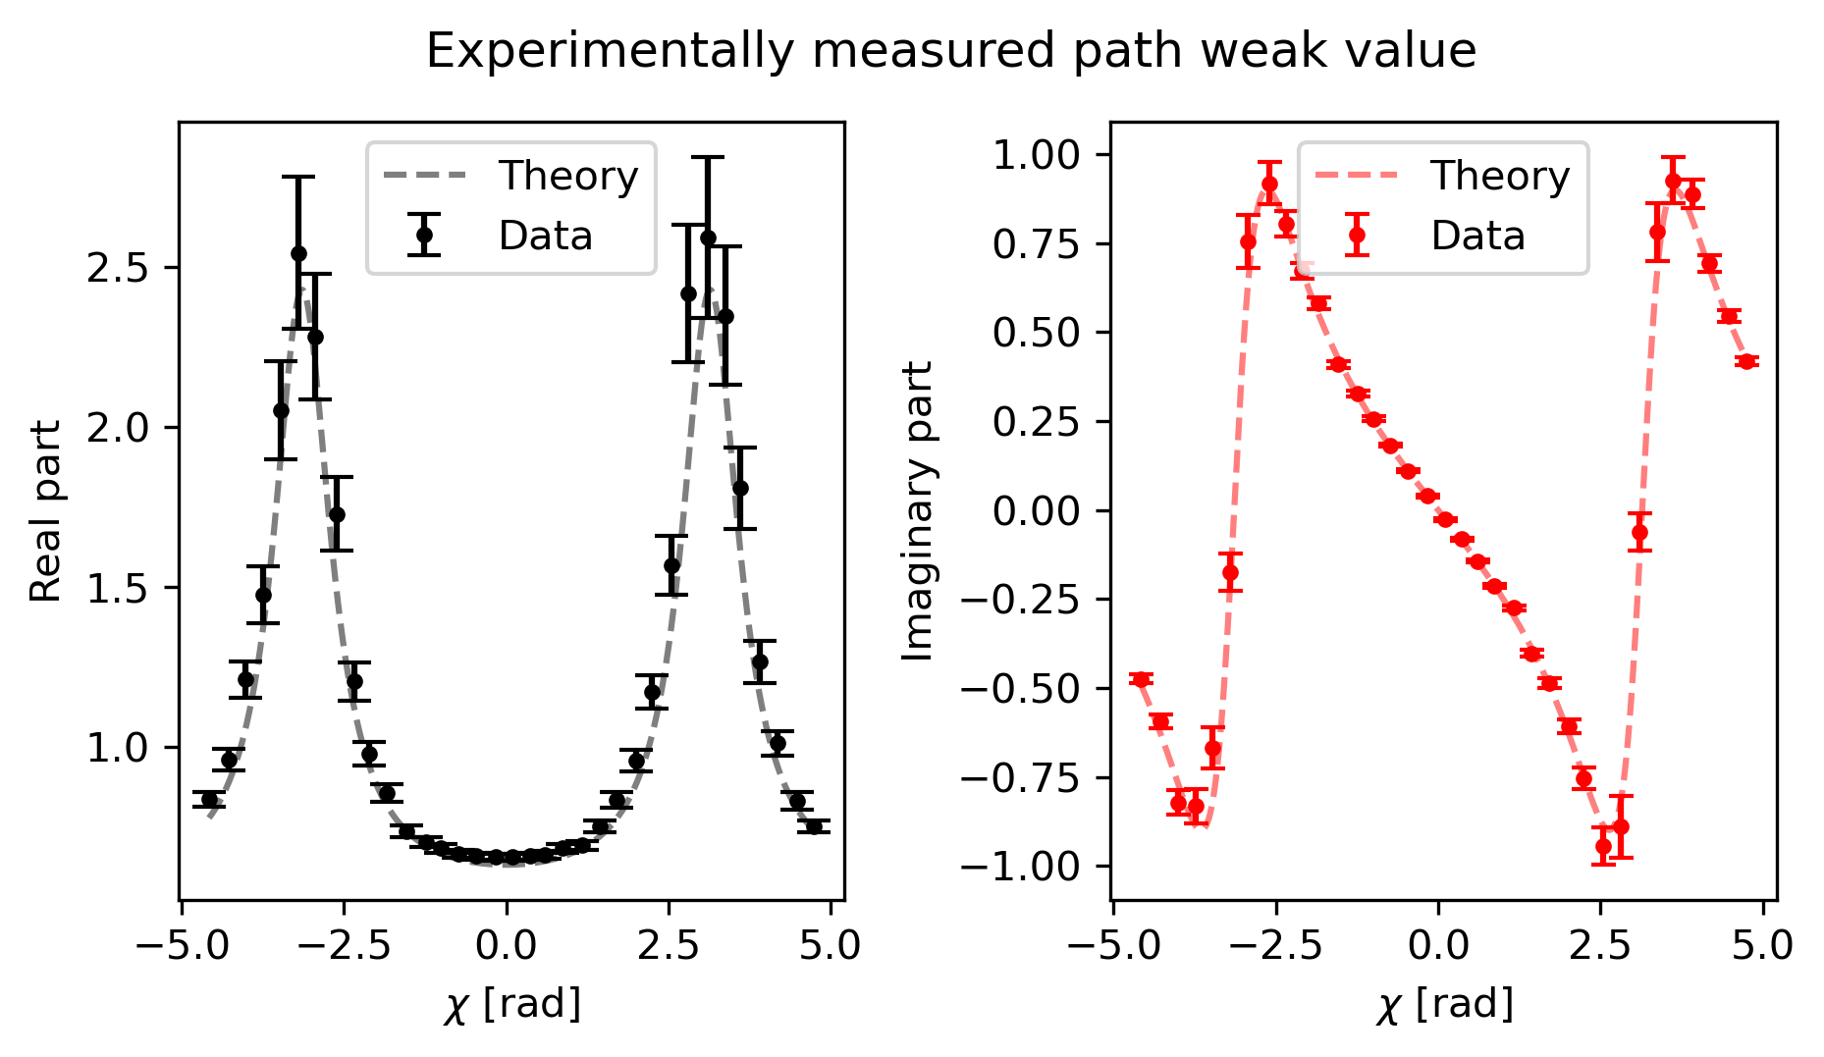
Results: Weak value of path 1

Slide 81
Interpretation of the results

Slide 82

Interpretation of the results

Slide 83


Aknowledgements
I. V. Masiello¹, A. Dvorak¹, H. Lemmel^{1,2}, and Y. Hasegawa^{1,3}
¹Atominstitut, TU Wien, Stadionallee 2, 1020 Vienna, Austria
²Institut Laue-Langevin, 71 avenue des Martyrs, 38000 Grenoble, France
³Department of Applied Physics, Hokkaido University, Kita-ku, Sapporo 060-8628, Japan

Slide 84
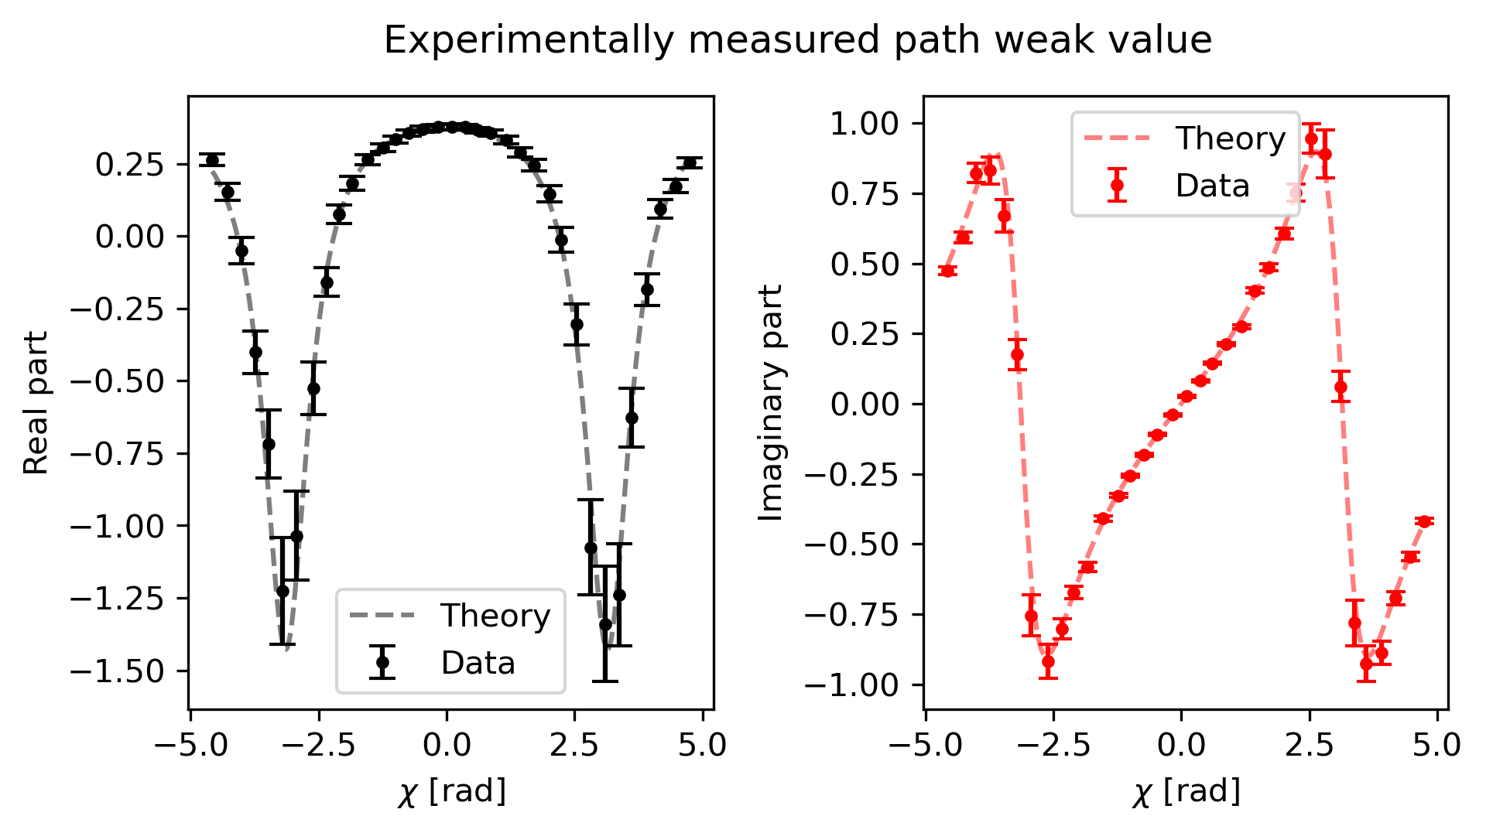
Thanks for your time!

